Slide 1
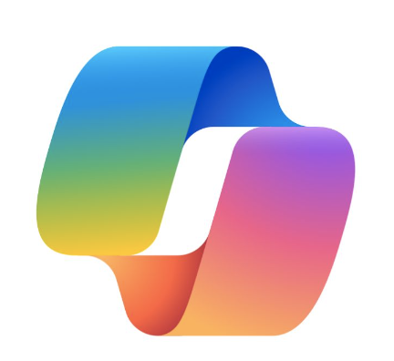

Introduction to Copilot Extensibility & Agents
alexander.Kastil@integrations.at

Slide 2
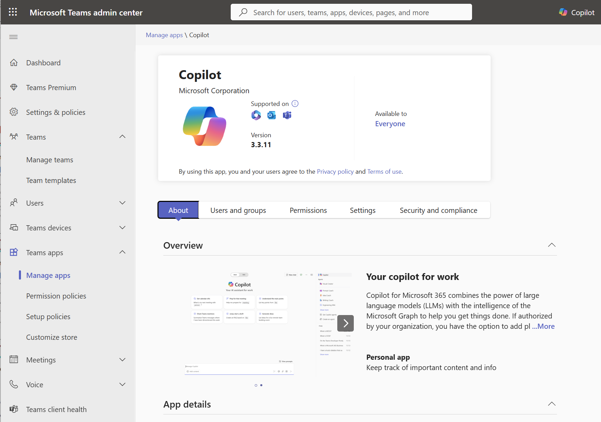
Teams Admin Center
The Teams Admin Center is a portal designed for managing and configuring Microsoft Teams within an organization.
You can govern all Teams apps available in your organization’s app catalog, define access to apps using policies, and manage app rollouts based on organizational needs.

Slide 3
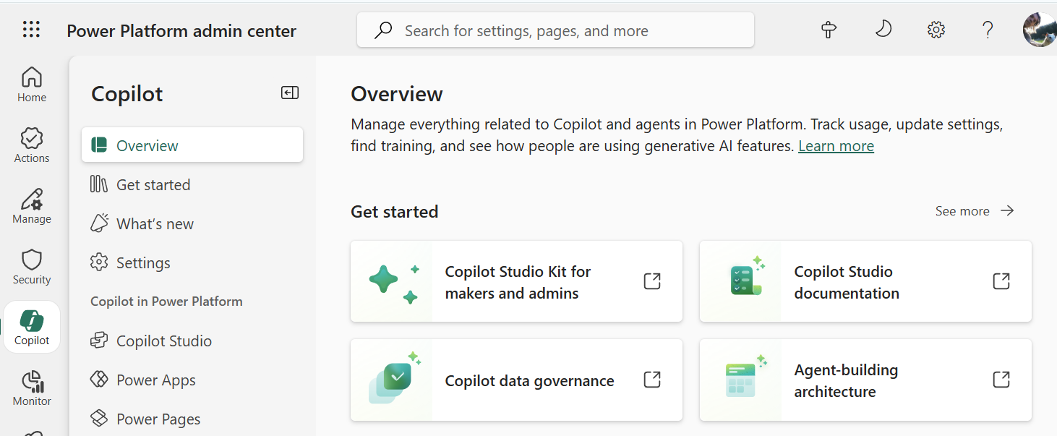
Power Platform Admin Center
Available at https://admin.powerplatform.microsoft.com/
Key Features:
Centralized Management
Environment
Data Loss Prevention (DLP) Policies
Analytics & Monitoring
Integration with Microsoft 365 & Azure

Slide 4
Power Platform Admin Center - Areas
Feature Area | Description
Actions | View recommendations about your Power Platform implementation. The recommendations enhance security, reliability, and overall health of your implementation.
Manage | Manage your environments, environment groups, and tenant settings.
Monitor | Measure and improve operational health metrics of resources built or deployed in Power Platform, such as apps.
Security | Run your organizational workloads in the safest way possible with a wide set of security features available.
Deployment | Provides a streamlined experience to help administrators navigate the complexities of managing Power Platform application lifecycle management (ALM) workloads, including managing pipelines deployments at enterprise scale.
Licensing | View a summary of environments in your tenant requiring licensing attention and license consumption for your environments.
Copilot | Access educational resources, track usage, and access governance controls about Copilot features.

Slide 5
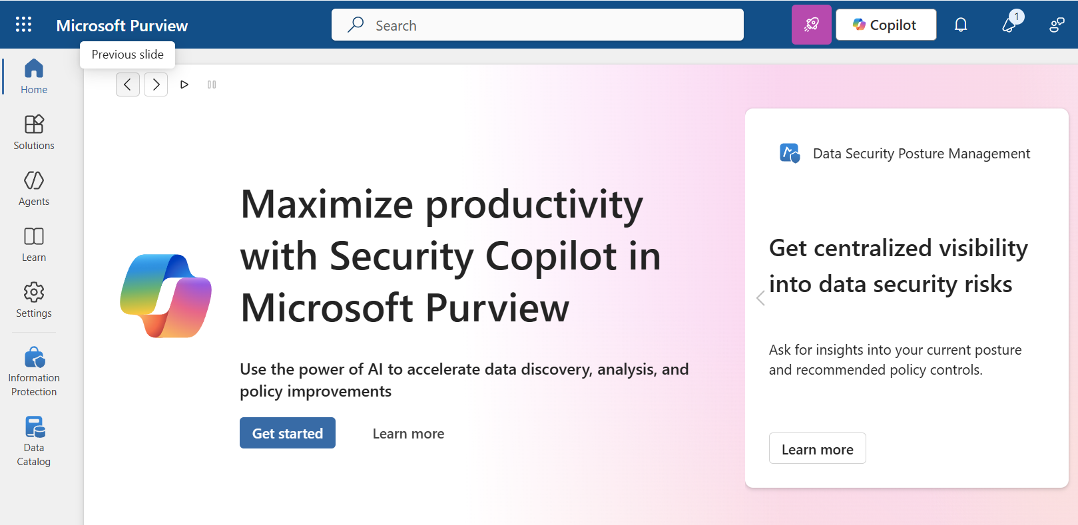
Microsoft Purview
Microsoft Purview integrates directly with Copilot Studio to ensure consistent governance, compliance, and data protection across all Copilot interactions:
Unified Data Security for Custom AI
DSPM for AI (Data Security Posture Management)
Enterprise-Grade Compliance & Auditing
Role-Based Insights & Controls

